Slide 1
20190211
Machine Learning를 이용한 Photonics paper research
Lee Jong Geon

Slide 2
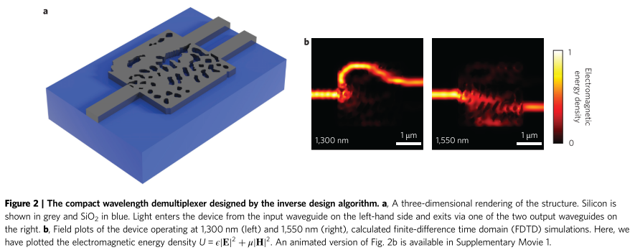
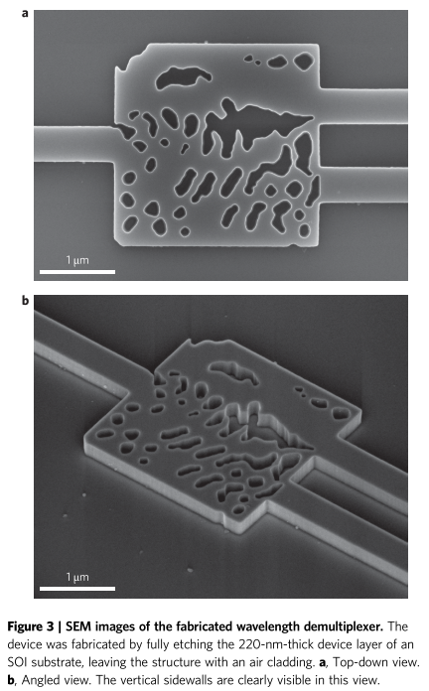
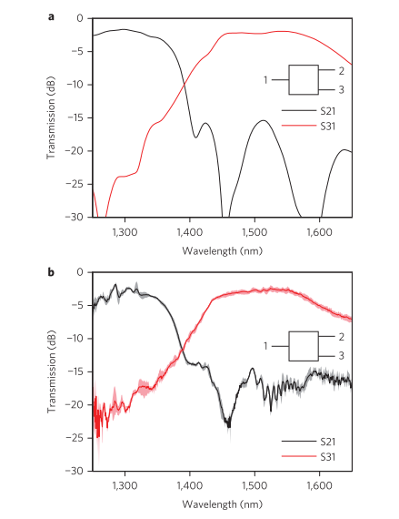
2015-Nature Photonics-9-Inverse design and demonstration of a compact and broadband on-chip wavelength demultiplexer (Alexander Y. Piggott, Jesse Lu, Konstantinos G. Lagoudakis, Jan Petykiewicz, Thomas M. Babinec and Jelena Vučković)
2.8 x 2.8 um²
Si (n = 3.49), SiO₂(n = 1.45)
Fabricate: electron-beam lithography followed by plasma etching
‘Alternating Directions Method of Multiplers (ADMM) optimization algorithm’
Stanford ‘Nanoscale and Quantum Photonics Lab’ (Prof. Jelena Vučković)

Slide 3
MATLAB code 분석
Algorithm 이해
-> Implementation 구상

